Slide 1

DriverPass System Analysis
Robert LaMarche
Notes:
[No speaker notes required for this slide.]

Slide 2

System Requirements
Functional Requirements
User Account Management: The system shall allow users to register for an account, log in, and reset passwords securely.
Reservation Management: The system shall enable users to book, modify, or cancel driving lessons and track their training progress.
Nonfunctional Requirements
Performance: The system must handle multiple concurrent users with a response time of under 2 seconds for most operations.
Security: All client-server communications shall use end-to-end encryption (SSL/TLS), and accounts will lock after 5 failed login attempts, with alerts sent to the admin.
Notes:
The DriverPass system includes key functional requirements like user account management, allowing customers to register, log in, and reset passwords independently, as well as reservation management for booking, modifying, or canceling driving lessons. These features streamline operations and enhance customer convenience. The nonfunctional requirements focus on performance, ensuring fast response times under 2 seconds even during peak usage, and security, with SSL/TLS encryption and account lockouts after multiple failed login attempts. Together, these requirements deliver a secure, reliable, and user-friendly system that meets DriverPass’s business needs.

Slide 3
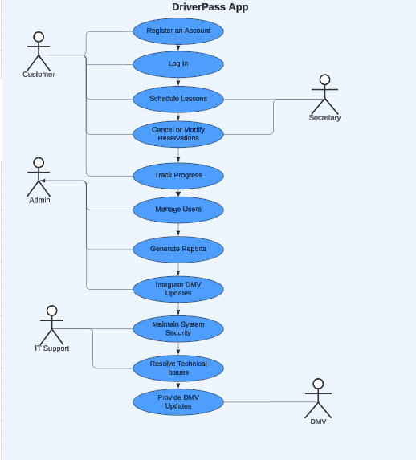
Use Case Diagram
[Insert your use case diagram here.]
Notes:
The DriverPass system involves several key users, including customers, secretaries, administrators, IT support, and the DMV. Customers can create accounts, log in, and schedule or modify driving lessons. Secretaries manage reservations and assist with customer account-related tasks. Administrators have full access to manage users, generate reports, and oversee system functionality. IT support ensures system maintenance, security, and updates, while the DMV is responsible for providing updates on testing rules and requirements. This design caters to DriverPass's needs by offering a user-friendly, role-based system that ensures secure, efficient operations for both staff and students.

Slide 4
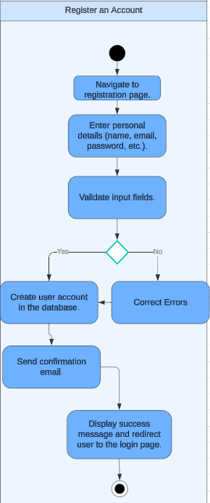
Activity Diagram
Notes:
In the "Register an Account" process, the user begins by providing their personal information, such as name and email address. Once the information is entered, the system checks if the email is already in use. If the email is unique, the system then prompts the user to create a password. Afterward, the user submits the registration request, and the system sends a confirmation email for account verification. Once the user verifies their email, the account is successfully created, allowing them to log in.
This process is designed to meet DriverPass’s needs by ensuring secure account creation, validating user information, and offering a straightforward experience for customers. By confirming the user’s email, the system prevents unauthorized access and provides a secure entry point for students to book lessons and track their progress.

Slide 5
Security
User Authentication: Users are required to log in with a unique username (email) and a secure password.
Password Strength Requirements: The system enforces strong password criteria to ensure account security.
Multi-factor Authentication (MFA): Option for multi-factor authentication to provide an additional layer of security during login.
Account Lockout After Failed Attempts: User accounts are temporarily locked after five failed login attempts, alerting administrators of potential brute-force attacks.
Data Encryption: All data exchanged between users and the system is encrypted using SSL/TLS protocols to protect sensitive information.
Email Verification: A confirmation email is sent during account registration, ensuring the user’s email address is legitimate and accessible.
Role-Based Access Control: Different access levels are assigned to users based on their roles (e.g., admin, secretary, customer, IT support), ensuring secure and appropriate access to system features.
Regular Security Patches and Updates: The system is regularly updated with security patches to address new vulnerabilities and ensure compliance with the latest security standards.
Monitoring and Alerts: Continuous monitoring of user activity, with automated alerts sent to administrators for suspicious behavior or system irregularities.
Notes:
In designing the DriverPass system, I focused on ensuring the security of both user data and system access. To protect users, the system requires each person to create an account with a unique email and strong password. For added security, there’s an option for multi-factor authentication, where users must verify their identity in a second way, such as through a text message or app. Additionally, if there are too many incorrect login attempts, the system will lock the account temporarily to prevent unauthorized access.
Sensitive data is always encrypted, which means that it’s protected during transmission to avoid unauthorized interception. During the registration process, users will receive an email to confirm their address, ensuring it’s valid and belongs to them. Different users, such as administrators and customers, have specific access based on their role, preventing access to sensitive areas unless authorized. The system also continuously monitors user activities and alerts the administrators of any unusual behavior, keeping everything secure. Finally, regular security updates will ensure the system stays protected against any new threats.

Slide 6
System Limitations
Limited Customization of Training Packages: Users cannot add or remove training package options without developer assistance.
No Real-Time Driving Session Tracking: The system does not include GPS tracking or real-time monitoring of in-car driving sessions.
Initial Deployment Focus: The initial version of the system will focus on core features, with future updates planned for scalability.
Platform-Specific Constraints: While the system is web-based, there may be occasional compatibility issues with older browsers or operating systems.
Budget Constraints: Certain advanced features, such as voice recognition for user interactions, may be excluded due to budget limitations.
Manual Integration for DMV Updates: Updates to DMV rules or tests will need to be manually reviewed and integrated by administrators.
Notes:
The design of the system includes a few limitations. First, users won’t be able to customize the training packages themselves and will need developer assistance if changes are necessary. The system also does not track real-time driving sessions, such as using GPS, which could limit some features for tracking in-car lessons. Additionally, the first version of the system will focus on the essential features, with plans for future updates to improve and expand it. There might also be occasional compatibility issues with older browsers or operating systems. Due to budget limitations, certain advanced features, like voice recognition, are not included at this time. Finally, when there are updates to DMV rules or tests, administrators will need to manually review and integrate these changes into the system.

